Slide 1

On behalf of the Arctic Domain Awareness Center (ADAC) and the University of Alaska…
ADAC’s Arctic C-ICE March 16-17, 2021
Welcome
to the
2021 Arctic Challenges, Innovations, and Commerce Expo (Arctic C-ICE)

Slide 2




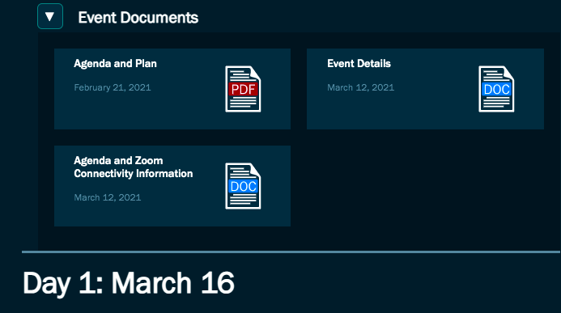
Technical Overview of the Expo
ADAC’s Arctic C-ICE March 16-17, 2021: Day 1
1.
4.
https://arcticdomainawarenesscenter.org
2.
and/or
3.

Slide 3

An Introduction to ADAC and the Context of this Expo
Presented by…
ADAC’s Arctic C-ICE March 16-17: Day 1
0745-0810 AKDT/1145-1210 EDT
Maj Gen (ret) Randy “Church” Kee
Executive Director of the Arctic Domain Awareness Center (ADAC)

Slide 4
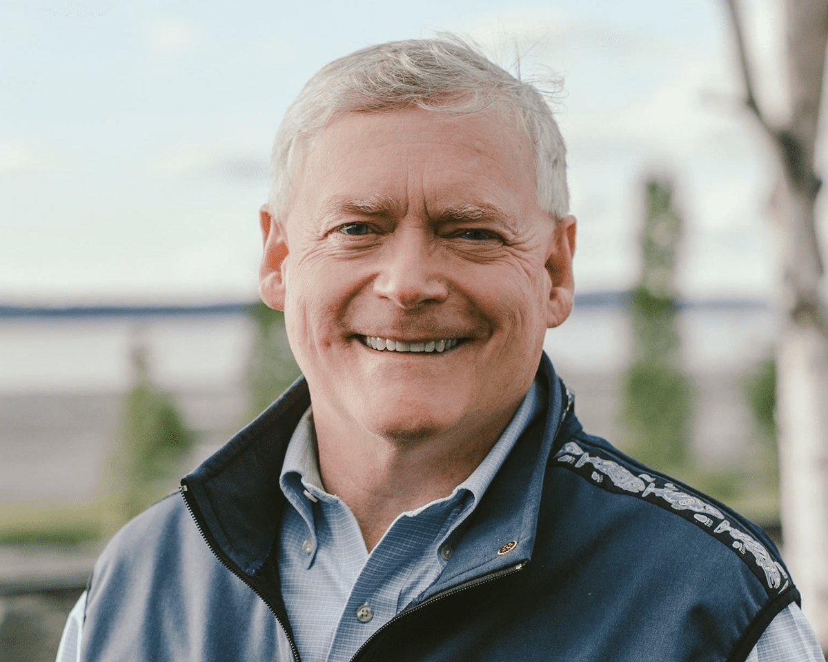
Introductory Keynote Presentation: Arctic Innovation & Technology
Presented by…
ADAC’s Arctic C-ICE March 16-17: Day 1
0810-0850 AKDT/1210-1250 EDT
Mr. Mead Treadwell
Co-Chair, The Wilson Center Polar Institute
Lieutenant Governor of Alaska (2010-14)
Chair, US Arctic Research Commission (2006-2010)
Chair/CEO Qilak LNG
Vice Chair, Alaska, A2A Rail
Chair, Iridium Polar Advisory Board

Slide 5
Break
ADAC’s Arctic C-ICE March 16-17: Day 1
0850-0900 AKDT/1250-1300 EDT

Slide 6
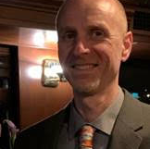
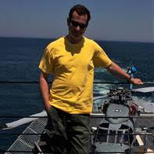
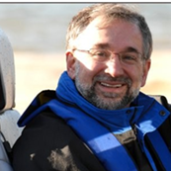


Track #1: Exploration – Emerging Solutions to the Arctic Communication Challenge
Presented by…
ADAC’s Arctic C-ICE March 16-17: Day 1
0900-0930 AKDT/1300-1330 EDT
Bruce Heinrich
Program Director, Maritime Warfare Systems, ASRC Federal Mission Solutions
Steve Kacenjar (PhD.)
Chief Scientist at Lockheed Martin, and CTO at BioTSI
Steve Specht
Chief Engineer, Army Technologies for ASRC’s MSS Division
Mike Berenato Solutions Architect with ASRC Federal Mission Solutions
Orest Ukrainsky Director of Innovation at ASRC Mission Software Solutions

Slide 7
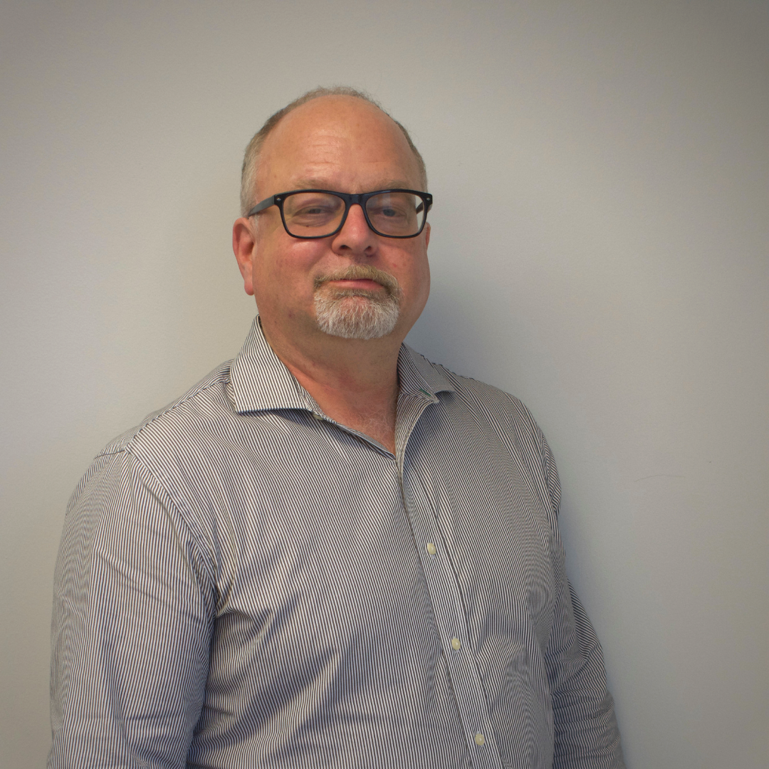
Track #2: Arctic Risks, Challenges, and Innovative Solutions - Sustainable Approaches to Arctic Challenges
Presented by…
ADAC’s Arctic C-ICE March 16-17: Day 1
0930-1000 AKDT/1330-1400 EDT
Mr. Odilon Lemieux
President at Borrum Energy Solutions (BES) Inc.

Slide 8
Break
ADAC’s Arctic C-ICE March 16-17: Day 1
1000-1010 AKDT/1400-1410 EDT

Slide 9
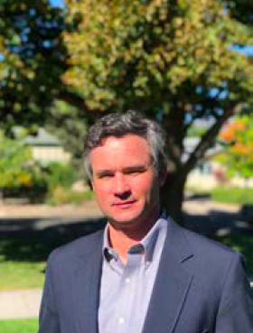
Track #3 – Domain: Emerging Communications Technologies
Presented by…
ADAC’s Arctic C-ICE March 16-17: Day 1
1010-1040 AKDT/1410-1440 EDT
Mr. Charlie Lever
Director, Government Programs at Iridium Communications Inc.

Slide 10
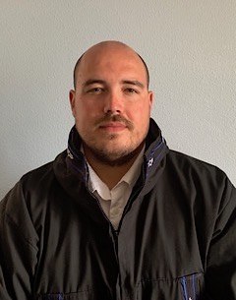
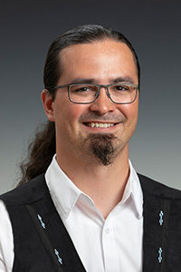
Keynote Presentation: Building Responsible Partnerships with Rural Alaska
Moderated and Presented by…
ADAC’s Arctic C-ICE March 16-17: Day 1
1045-1145 AKDT/1445-1545 EDT
Moderator: Mr. Kaare Sikuaq Erickson
Outreach & Engagement Manager for Ukpeaġvik Inupiat Corporation (UIC) in Utqiaġvik, Alaska, and a member of the Board of Directors for the Arctic Research Consortium of the United States
Nagruk Harcharek
Ukpeaġvik Iñupiat Corporation (UIC), Director of Operations
Twyla Aanauraq Thurmond
Native Village of Shishmaref, Community Coordinator

Slide 11
Break
ADAC’s Arctic C-ICE March 16-17: Day 1
1145-1200 AKDT/1545-1600 EDT

Slide 12
Solutions Showcase Overview: Virtual Exhibit Booths
ADAC’s Arctic C-ICE March 16-17: Day 1
1200-1210 AKDT/1600-1610 EDT
The Solutions Showcase will take place from 1210-1330 AKST/1610-1730 EST within the “Susitna Hall” via this Zoom link: https://alaska.zoom.us/j/86812738030
Booth 1
ADAC’s Arctic Vessel Monitoring, Geofencing & Alert Awareness Project
Booth 2
ADAC’s Remote Unmanned Aircraft System (UAS) Project
Booth 3
ADAC’s Arctic Maritime Spills Modeling Project
Booth 4
ADAC’s Ice Conditions Index for the Arctic
Booth 5
ADAC’s Marine Induced Polarization Project
Booth 6
ADAC’s Long Range Autonomous Underwater Vehicle (LRAUV) Project
Booth 7
FarSounder
Booth 8
Borrum Energy Solutions Inc.

Slide 13
Welcome to the
Arctic C-ICE Solutions Showcase
ADAC’s Arctic C-ICE March 16-17: Day 1
1210-1330 AKDT/1610-1730 EDT
Booth 1
ADAC’s Arctic Vessel Monitoring, Geofencing & Alert Awareness Project
Booth 2
ADAC’s Remote Unmanned Aircraft System (UAS) Project
Booth 3
ADAC’s Arctic Maritime Spills Modeling Project
Booth 4
ADAC’s Ice Conditions Index for the Arctic
Booth 5
ADAC’s Marine Induced Polarization Project
Booth 6
ADAC’s Long Range Autonomous Underwater Vehicle (LRAUV) Project
Booth 7
FarSounder
Booth 8
Borrum Energy Solutions Inc.

Slide 14
Thank You

